Slide 1


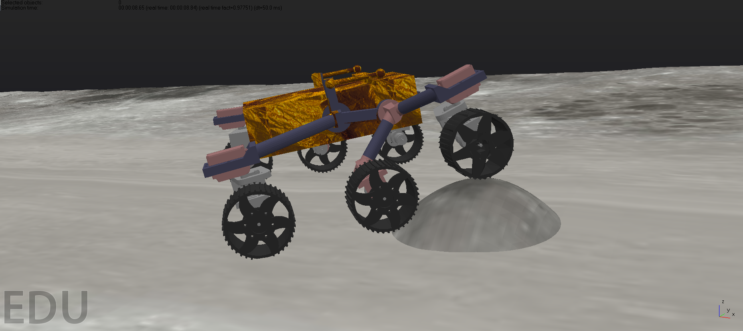
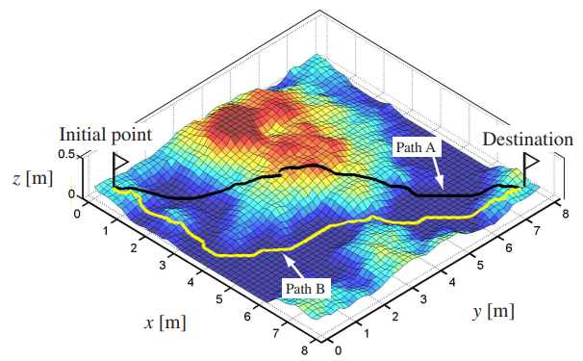
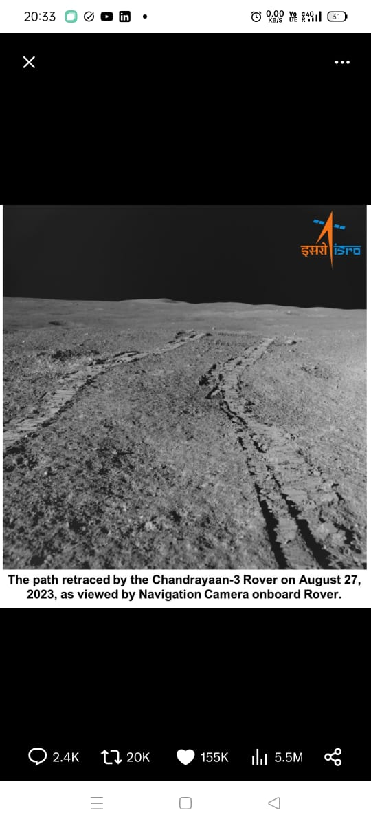
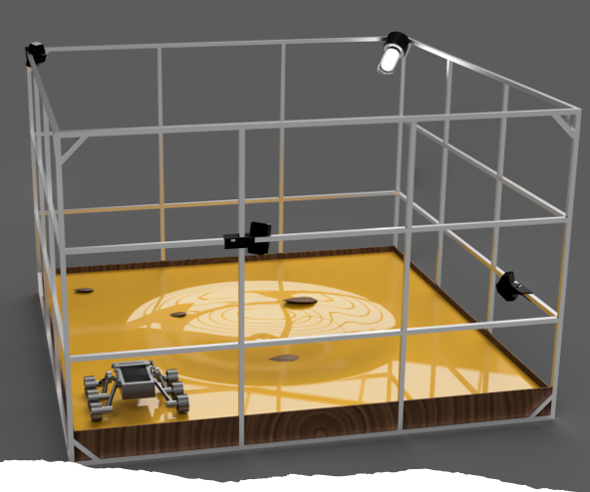
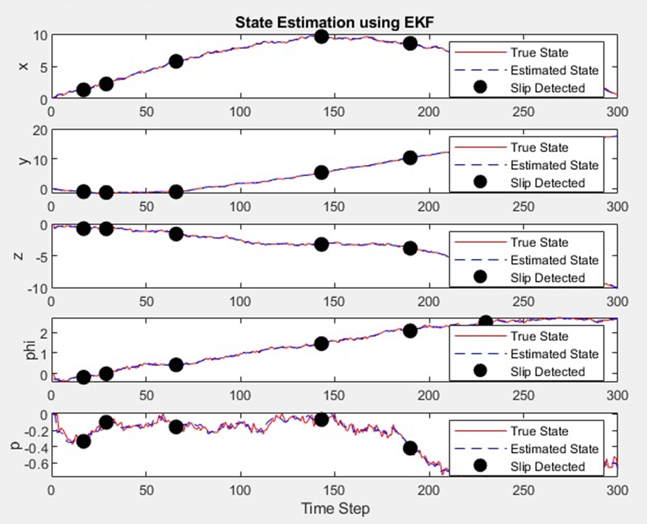
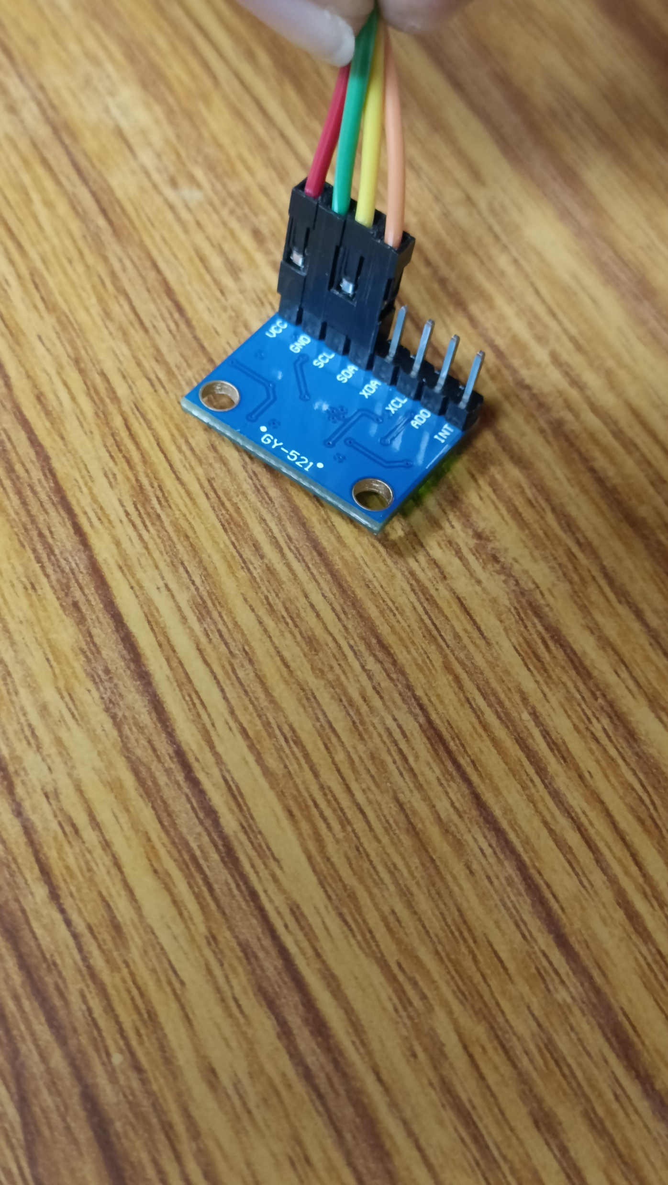
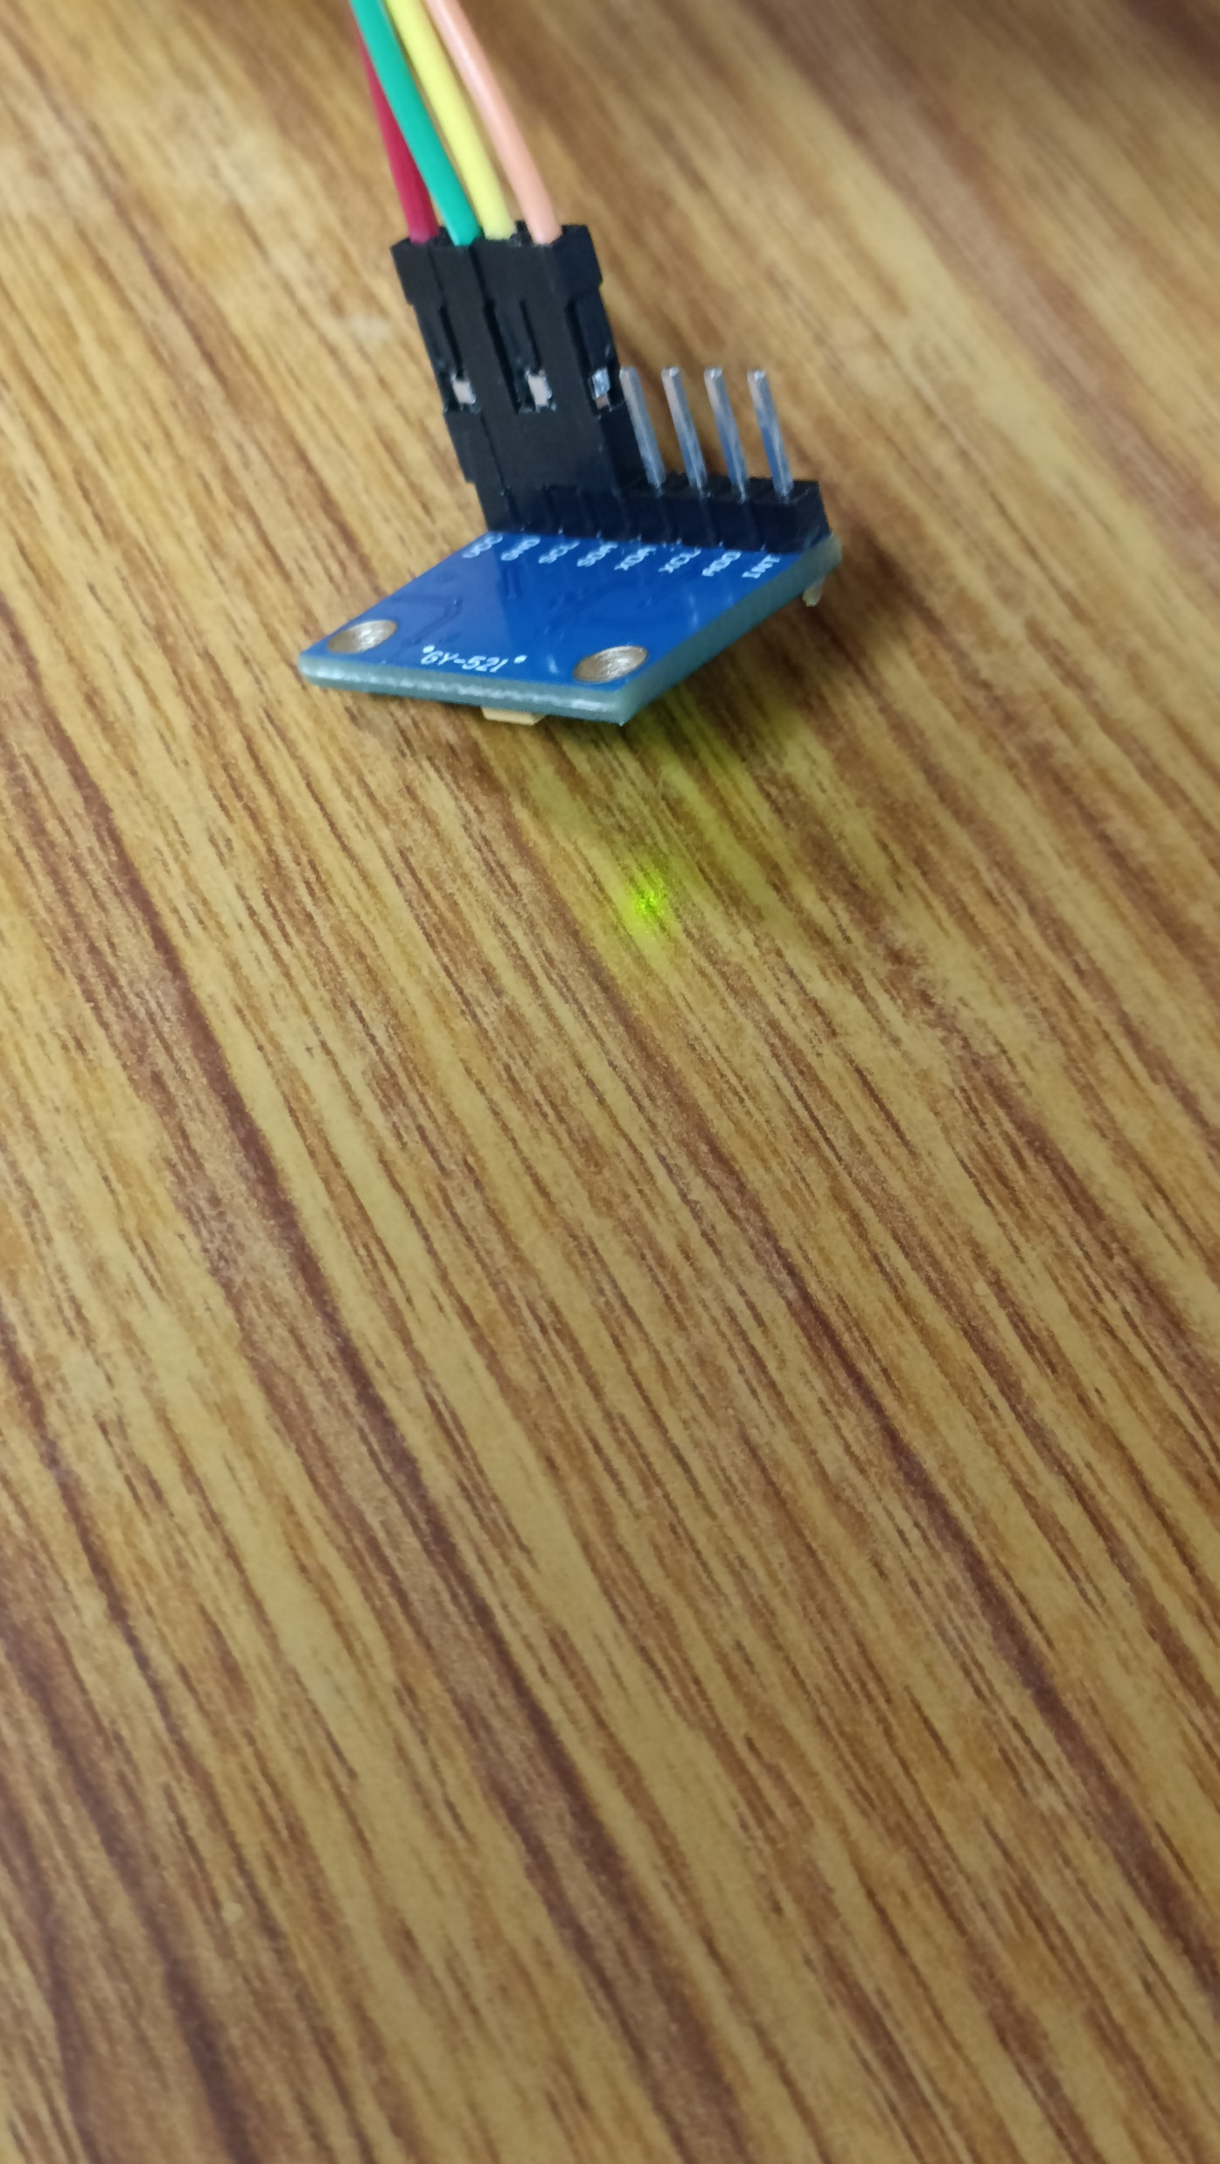
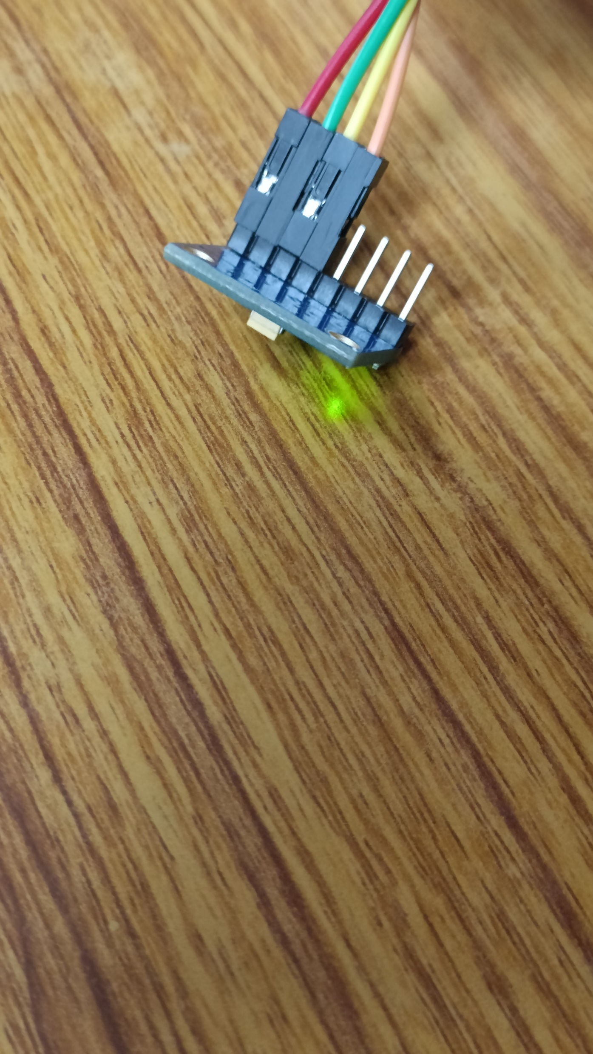

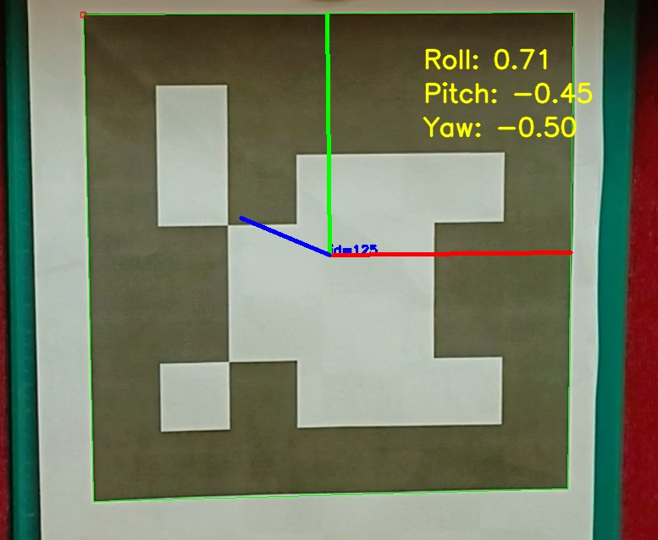
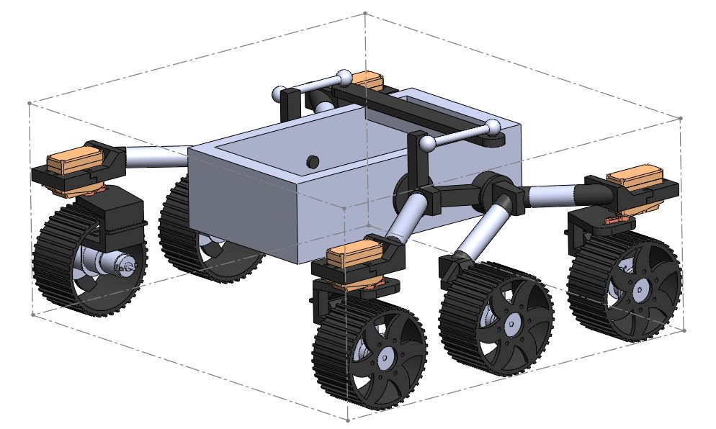
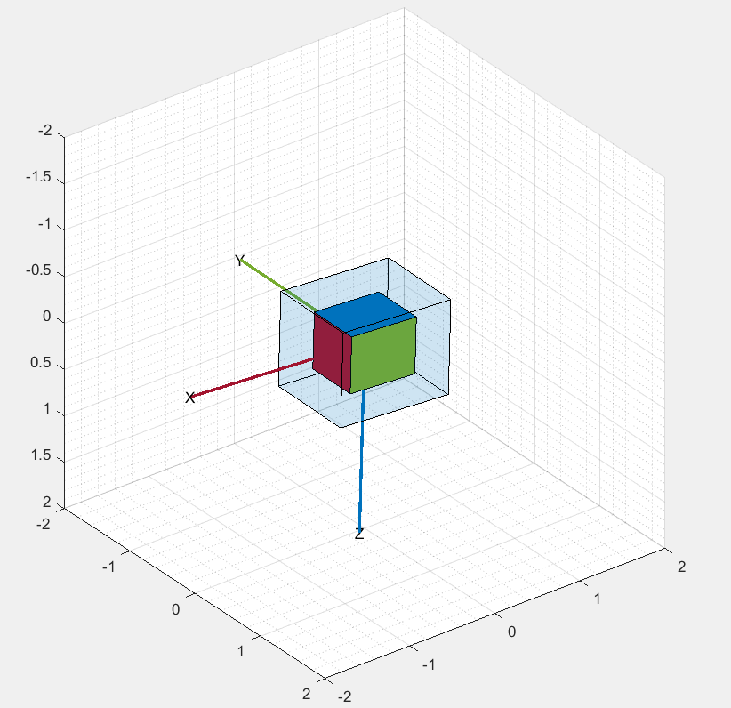
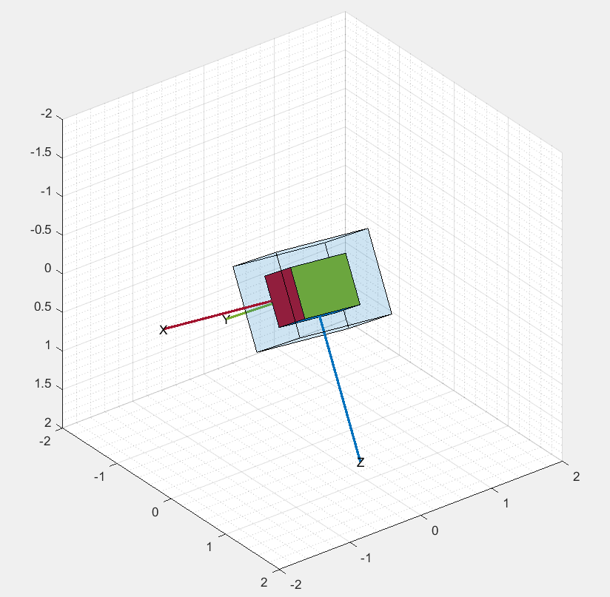
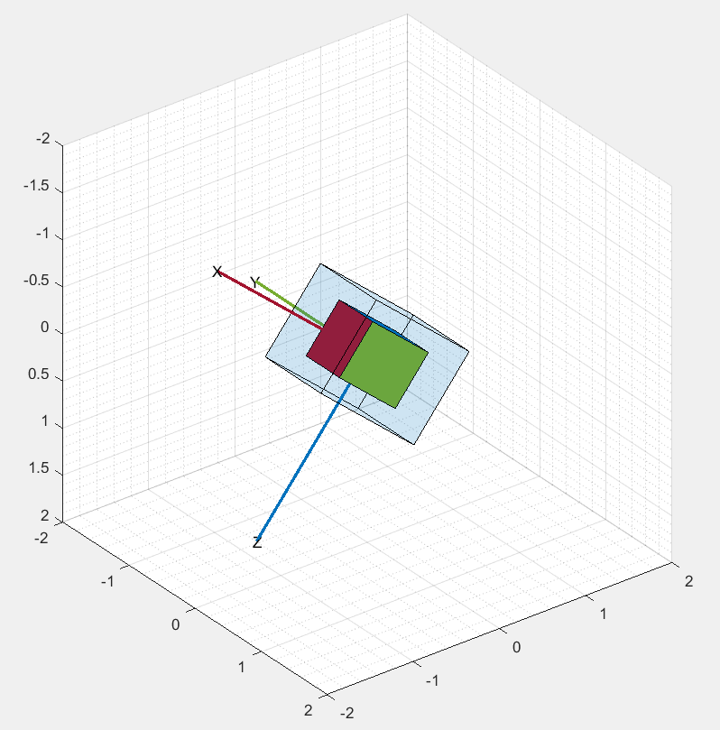
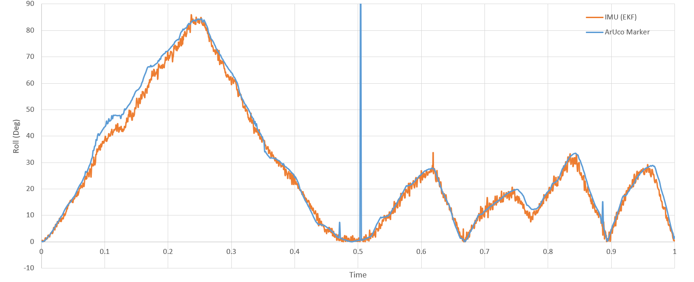
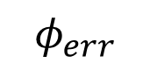
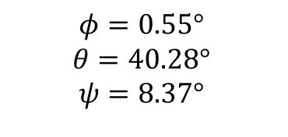
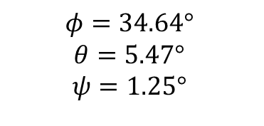
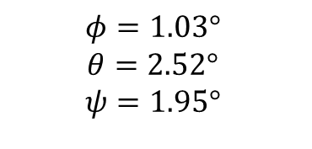
Laboratory Setup for Autonomous planetary rovers
Arya Das*, Ayush Agrawal, Dipak Kumar Giri *email: aryad22@iitk.ac.in
Department of Aerospace Engineering, Indian Institute of Technology Kanpur, Uttar Pradesh - 208016
AEROSPACE ENGINEERING
IIT KANPUR
Abstract
Rover-based exploration of planetary surfaces poses significant challenges due to varying terrain conditions that induce slip, leading to navigation errors and potential mission failures. This project focuses on the development of a laboratory setup designed to study slip measurement and compensation, and to enhance the autonomous mobility of planetary rovers. The laboratory setup consists of a six-wheeled rover with a rocker-bogie suspension and an arena with loose soil and various measurement systems. The rover will be equipped with sensors, such as camera, lidar, and IMU, to estimate its state and detect any potential slip. This data will then be used in a path-tracking controller to follow a desired trajectory. In the future, this facility may be used to develop algorithms for the autonomous mobility of extraterrestrial rovers, advancing our capabilities in space exploration.
Wheel Slippage
Simulation Model of Rover
Path Planning using DEM
Wheel slippage occurs when the wheels lose traction on the surface. This leading to inefficient movement and potential navigation errors. This phenomenon is particularly problematic on uneven or loose terrains, such as those found on Mars and the Moon. Understanding and mitigating wheel slippage is crucial for enhancing the performance and reliability of planetary rovers.
A simulated dynamic model of the rover has been built on the robotics simulation platform CoppeliaSim. Primitive convex shapes have been used for dynamics calculations, which results in a fast simulation. Sensors such as cameras and encoders have been added and an API has been built.
In addition to slip estimation and compensation methods, it is imperative to decide an efficient and safe path for the rover to take. Path planning must take factors like terrain roughness, slope angle, and solar illumination angle into consideration.
Reverse
Track
Figure 8: Path Planning on a DEM
Forward
Track
Figure 4: Simulated rover climbing over an obstacle
Path Following Algorithm
Guidance, Navigation and Control
Target
Heading
Reference
Path
Figure 1: Pragyan rover navcam photo showing wheel slippage.
Source: Twitter/X
The mobility operation of the rover is performed in 3 steps:
1. Map making: First, a 3D map of the surroundings is created, using camera and LiDAR data.
2. Guidance: Path planning is done to find a safe and efficient path through the terrain.
3. Navigation: Various sensors such as wheel encoders and cameras are used to determine the rover’s state as well as any slippage.
3. Control: A traction controller is used to limit the wheel slippage, and a slip-compensated path controller is used to ensure that the rover stays on the desired path.
$$φ_{err}$$
Current
Heading
Proposed Facility Design
Figure 9: Path following algorithm is used to guide the rover back to its path if it deviates from it due to any disturbance.
Dimensions: 4m x 4m (approx.)
Surface material: Dry, regular sand particles (0.2-1 mm particle size)
Surface features: Small rocks, slopes, craters
Lighting: Situated in a dark room with strong light sources.
Localization: Motion capture system using fiducial markers for ground truth localization
Terrain
Camera + Lidar
Digital Elevation Map
Path Planning
Simulation Results of Slip Detection
The system model was programmed in simulation and slip was randomly introduced at various points of time. The EKF model detected slip correctly at most of the points. Further test in hardware setup must be performed to check the performance of the model.
Figure 5: Path Planning flow of the rover
ref
Path Tracking
Controller
Inverse Kinematics
Plant
Extended Kalman Filter
Sensors
Slip Detector
IMU
Forward Kinematics
Camera
Figure 2: Proposed test facility with mock-up rover and lunar terrain simulation.
Encoder
Figure 6: Overall control diagram of the rover
Proposed Rover Design
Euler Angle Estimation
Figure 10: Estimated position and orientation of the rover
Proposed lab rover model with Rocker Bogie suspension and 4 steerable wheels. Sensors include cameras, lidar, wheel encoders and IMUs.
ArUco Marker vs IMU comparison
Servo Motor
Chassis
Differential Bar Mechanism
Bogie Link
26 cm
Rocker Link
58 cm
52 cm
$$φ=1.03°$$
$$θ=2.52°$$
$$ψ=1.95°$$
$$φ=34.64°$$
$$θ=5.47°$$
$$ψ=1.25°$$
$$φ=0.55°$$
$$θ=40.28°$$
$$ψ=8.37°$$
Figure 3: CAD model of the rover
Figure 7: Attitude Estimation using MPU-6050 IMU
Figure 11: Comparison between Roll Estimated using ArUco Marker and Extended Kalman Filter
ACKNOWLEDGEMENT: We would like to acknowledge the contributions of Pratik Kubal, Neelesh and Dhruv Patel.

